Slide 1

Note: The data and information in this document is reflective of a hypothetical situation and client. This document is to be used for KPMG Virtual Internship purposes only.
Sprocket Central Pty Ltd
Data analytics approach
Joseph Ishola

Slide 2
Note: The data and information in this document is reflective of a hypothetical situation and client. This document is to be used for KPMG Virtual Internship purposes only.
Agenda
Introduction
Data Exploration
Model Development
Interpretation

Slide 3
Note: The data and information in this document is reflective of a hypothetical situation and client. This document is to be used for KPMG Virtual Internship purposes only.
Introduction
Identify and Recommend High Value Customers
Outline of Problem
Approach for Data Analysis
Bike related purchases for the past 3 year based on gender.
Age distribution contributing to maximum profit.
Customer classification.
Numbers of cars owned in each state.
Wealth segment by age distribution.
Top industry contributing to profit and bike related purchases.
Sprocket Central specializes in high quality bike sales and other accessories
The marketing team is looking to boost sales
The team wants to know which customers to target that will bring value to their business

Slide 4
Note: The data and information in this document is reflective of a hypothetical situation and client. This document is to be used for KPMG Virtual Internship purposes only.
Data Exploration
Data Quality Assessment
Data quality issues that were resolved
 | Accuracy | Completeness | Consistency | Validity | Relevance | Currency
Customer Demographic | DOB: One inaccurate entry Age missing | Customer ID is incomplete Job Title, Last Name, Tenure contain blanks | Gender: Inconsistence | Default: Invalid | Default: Not relevant, deleted | Deceased customer filtered out
Customer Address |  | Customer ID is incomplete | State: Inconsistence | List Price, Product First Sold Date: Wrong Format
Transactions | Profit: missing | Customer ID is incomplete Online orders, Brands contain blanks |  |  | Cancelled status order filtered out

Slide 5
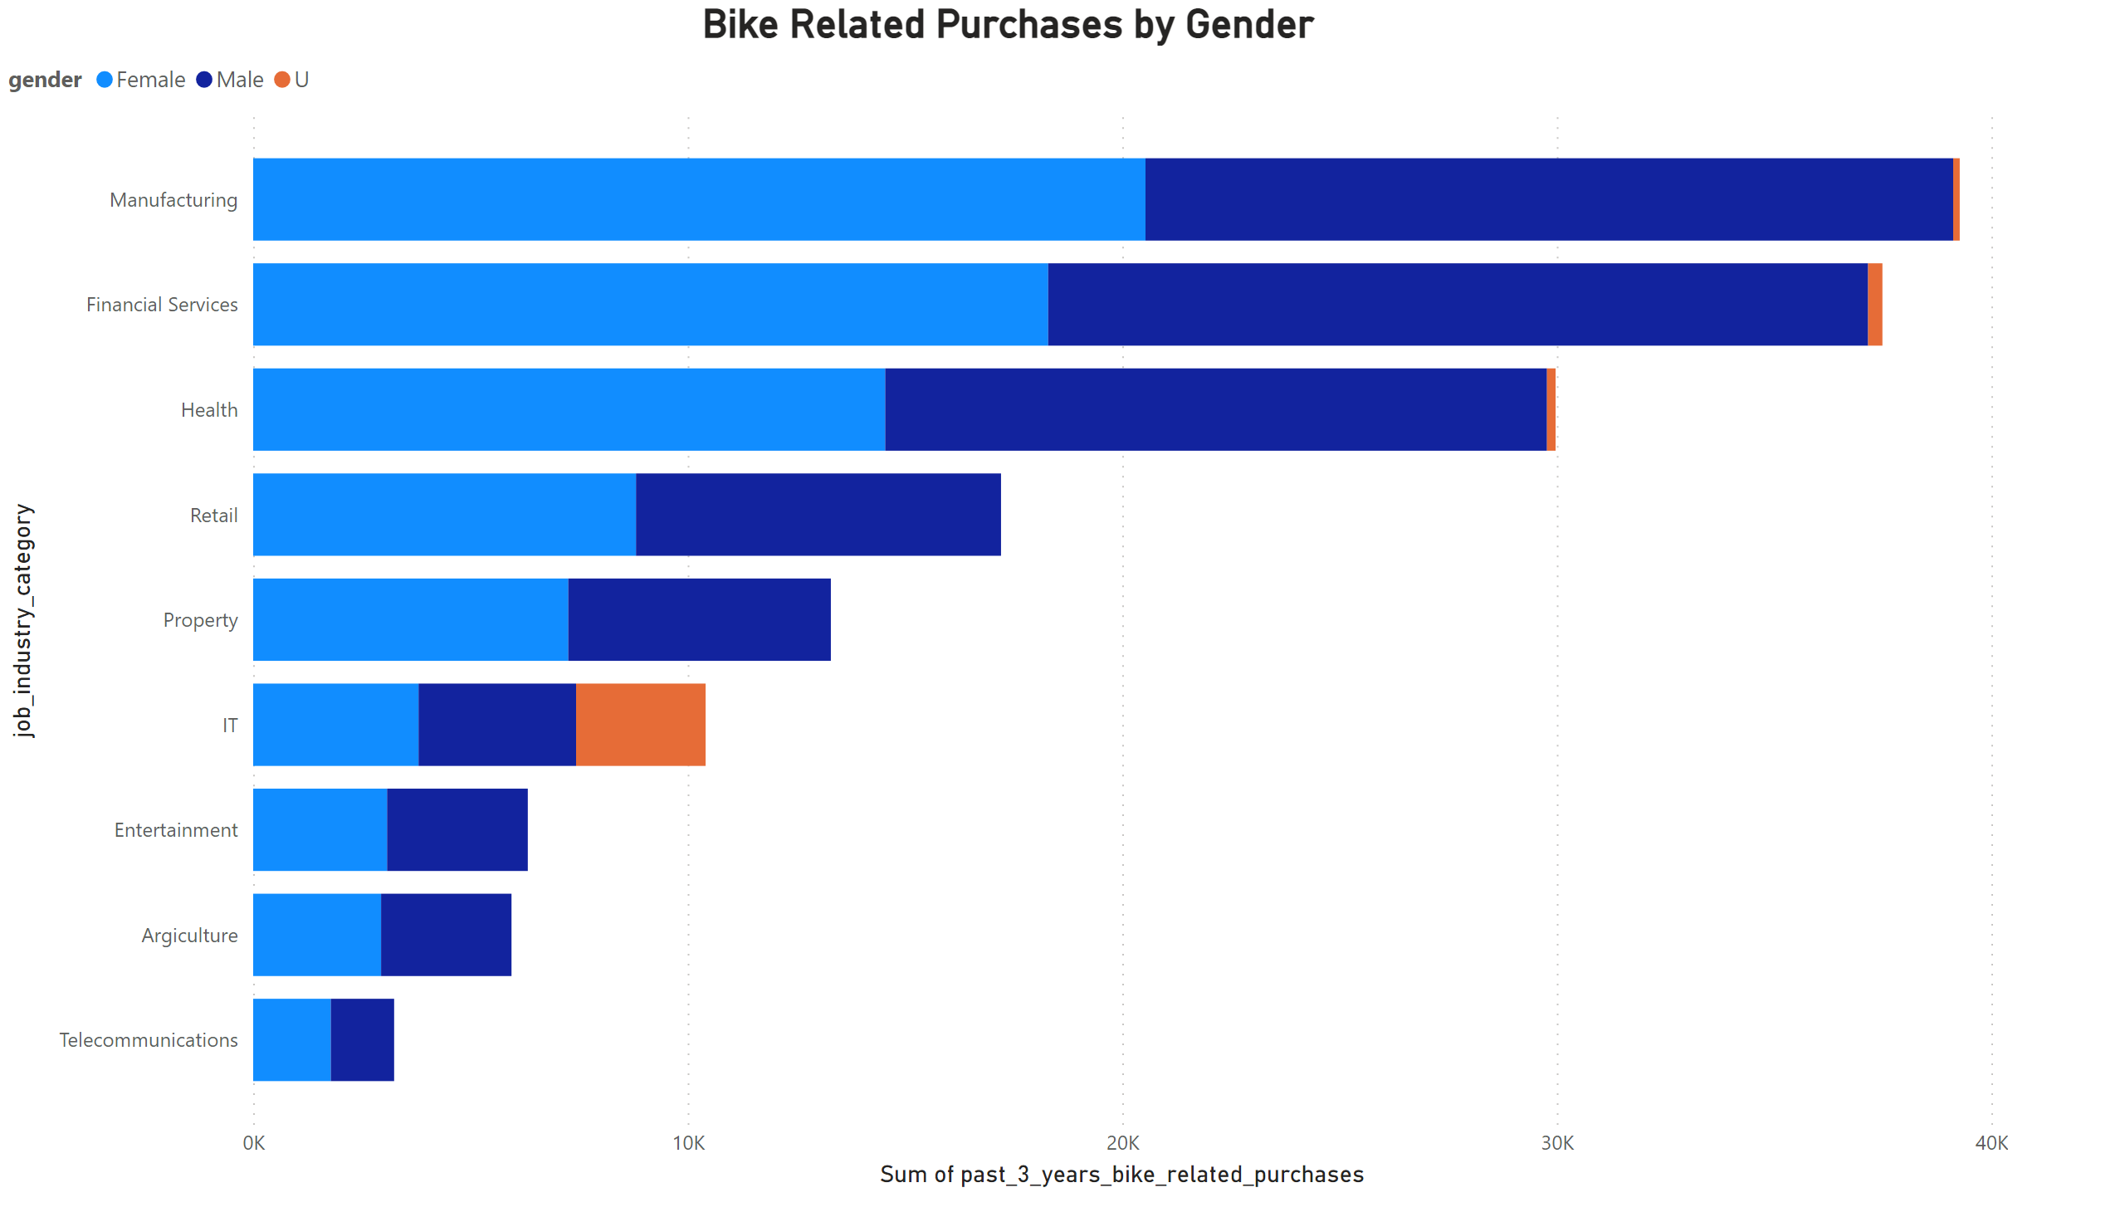
Note: The data and information in this document is reflective of a hypothetical situation and client. This document is to be used for KPMG Virtual Internship purposes only.
Data Exploration
Data Quality Assessment
Female had the highest total Sum of past 3 years bike related purchases at 98277, followed by Male at 93392 and U at 3659.
Manufacturing sector in the female gender made up 10.51% of Sum of past 3 years bike related purchases.
Therefore, Females in the Manufacturing sector should be the focus.

Slide 6
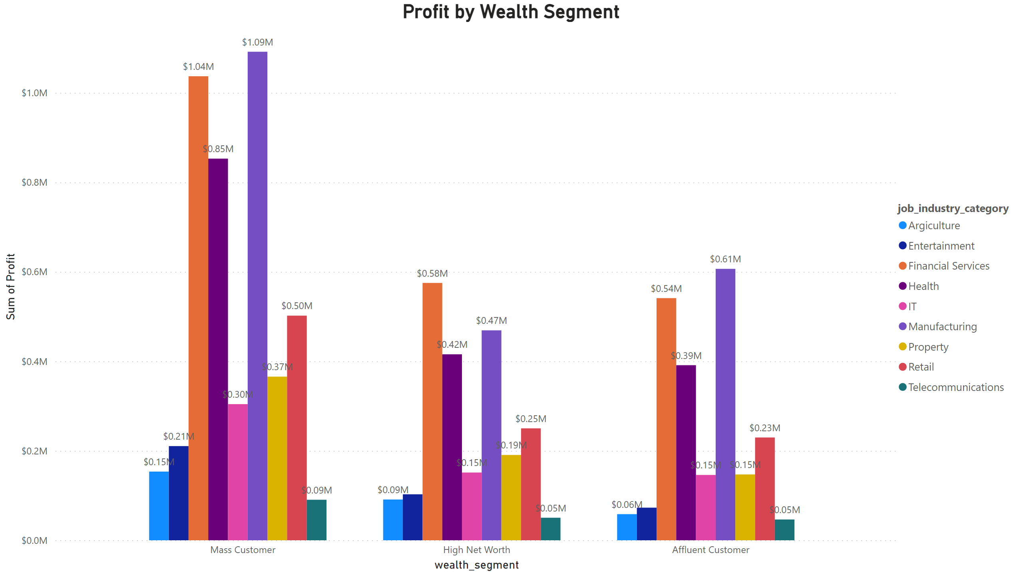
Note: The data and information in this document is reflective of a hypothetical situation and client. This document is to be used for KPMG Virtual Internship purposes only.
Data Exploration
Data Quality Assessment
﻿Mass Customer had the highest total Sum of Profit at $4,608,622.810000015, followed by High Net Worth at 2,296,514.65 and Affluent Customer at 2,239,801.30.﻿﻿
﻿Manufacturing accounted for 23.70% of Sum of Profit.﻿
The top 3 industries bringing in the most profit are Manufacturing, Financial Services and Health. This is obvious as the customers from these industries prefer bike because the industries are usually within the city.

Slide 7
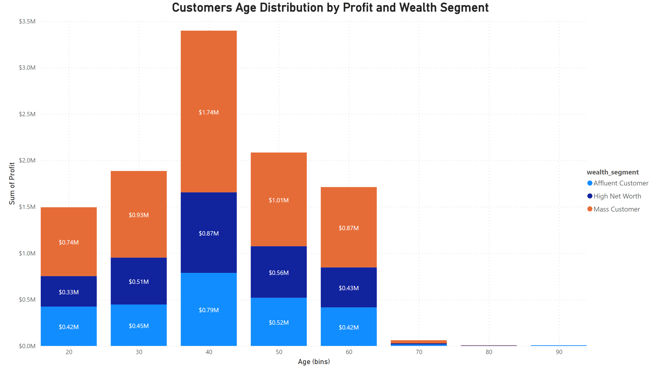
Note: The data and information in this document is reflective of a hypothetical situation and client. This document is to be used for KPMG Virtual Internship purposes only.
Data Exploration
Data Quality Assessment
﻿Mass Customer had the highest total Sum of Profit at $5,331,467.730000004, followed by High Net Worth at 2,706,108.50 and Affluent Customer at 2,614,289.86.﻿﻿
﻿﻿
﻿﻿40-50 years in Age distribution made up 15.96% of Sum of Profit.﻿﻿
﻿﻿
﻿﻿Therefore Mass customers in the age range of 40 – 50 are likely to bring more profits to the company compared to other age group.﻿﻿
﻿

Slide 8
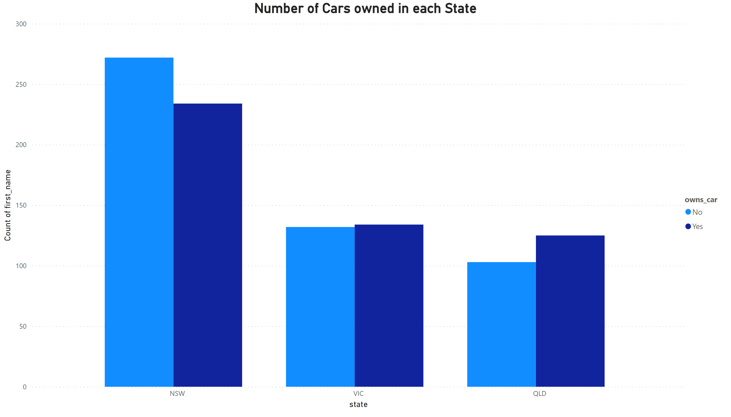
Note: The data and information in this document is reflective of a hypothetical situation and client. This document is to be used for KPMG Virtual Internship purposes only.
Data Exploration
Data Quality Assessment
﻿NSW, QLD and VIC could be potential market for the company because a great deal of new customers do not have a car.﻿﻿
﻿﻿
﻿﻿NSW is the eye catching market opportunity as the number with cars is as much as the number without cars.﻿﻿

Slide 9
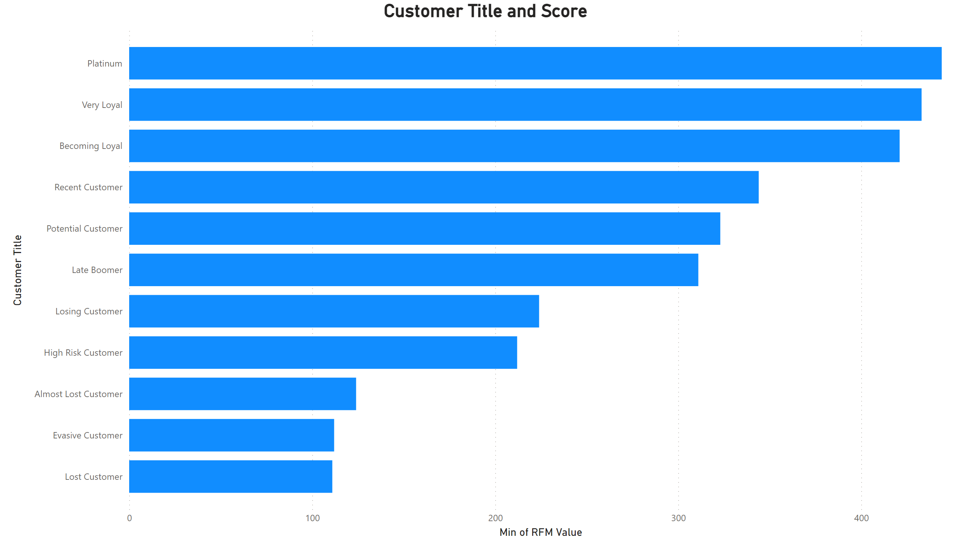
Note: The data and information in this document is reflective of a hypothetical situation and client. This document is to be used for KPMG Virtual Internship purposes only.
Model Development
RFM Analysis and Customer Classification
RFM (Recency, Frequency, Monetary value) analysis helps businesses gain insights into customer segments and tailor marketing strategies accordingly.
It can be used to identify valuable customers for targeted promotions, win back inactive customers, or personalize communication based on the customer's individual behavior.

Slide 10
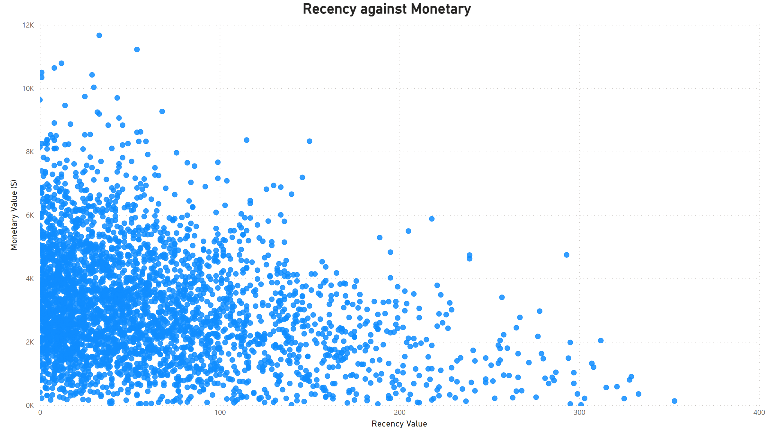
Note: The data and information in this document is reflective of a hypothetical situation and client. This document is to be used for KPMG Virtual Internship purposes only.
Model Development
Scatter plot based on RFM Analysis
Generally, customers who have made more recent purchases tend to have a higher monetary value. This relationship can provide insights into customer loyalty and engagement.
Customers located in the top-left quadrant of the plot, representing high recency and high monetary value, are typically considered high-value and active customers. They have made recent purchases and spent a significant amount of money. Businesses may focus on retaining and further engaging them.
Customers located in the top-right quadrant, representing high monetary value but low recency, may indicate potential churn or at-risk customers. These customers have spent a significant amount in the past but haven't made recent.

Slide 11
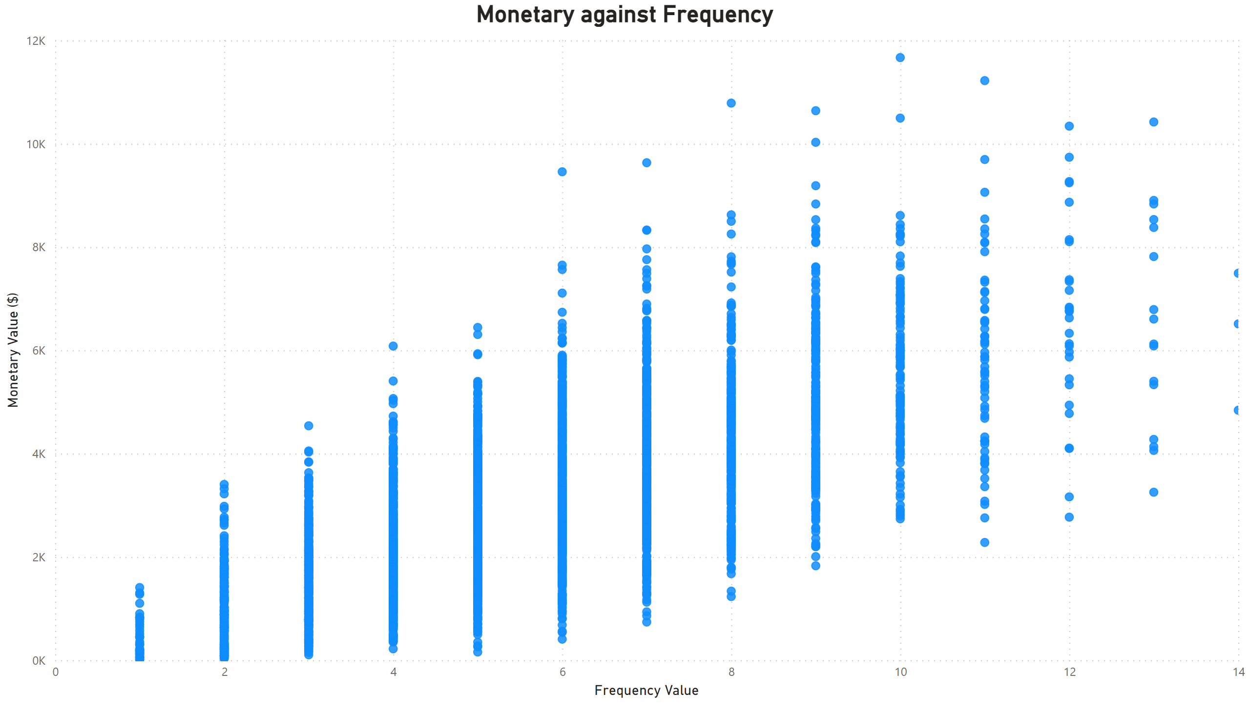
Note: The data and information in this document is reflective of a hypothetical situation and client. This document is to be used for KPMG Virtual Internship purposes only.
Model Development
Scatter plot based on RFM Analysis
Generally, customers who make more frequent purchases tend to have a higher monetary value.
Customers located in the top-right quadrant of the plot, representing high frequency and high monetary value, are typically considered high-value and frequent customers. They make purchases frequently and spend a significant amount of money. These customers are often the most loyal and valuable segment, and businesses may focus on retaining and nurturing their relationship.
Customers located in the top-left quadrant, representing high monetary value but low frequency, may present opportunities for upselling or cross-selling.

Slide 12
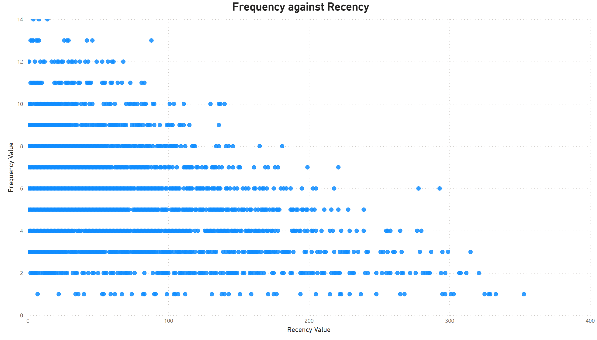
Note: The data and information in this document is reflective of a hypothetical situation and client. This document is to be used for KPMG Virtual Internship purposes only.
Model Development
Scatter plot based on RFM Analysis
Customers located in the top-left quadrant of the plot, representing high frequency and recent transactions, are considered active and engaged customers. They make transactions frequently and have made a purchase recently.
Customers in the bottom-left quadrant, representing low frequency but recent transactions, may represent new or sporadic customers. They have made a recent purchase but do not make transactions frequently. Businesses can focus on nurturing these relationships and encouraging more frequent purchases to increase their engagement.

Slide 13
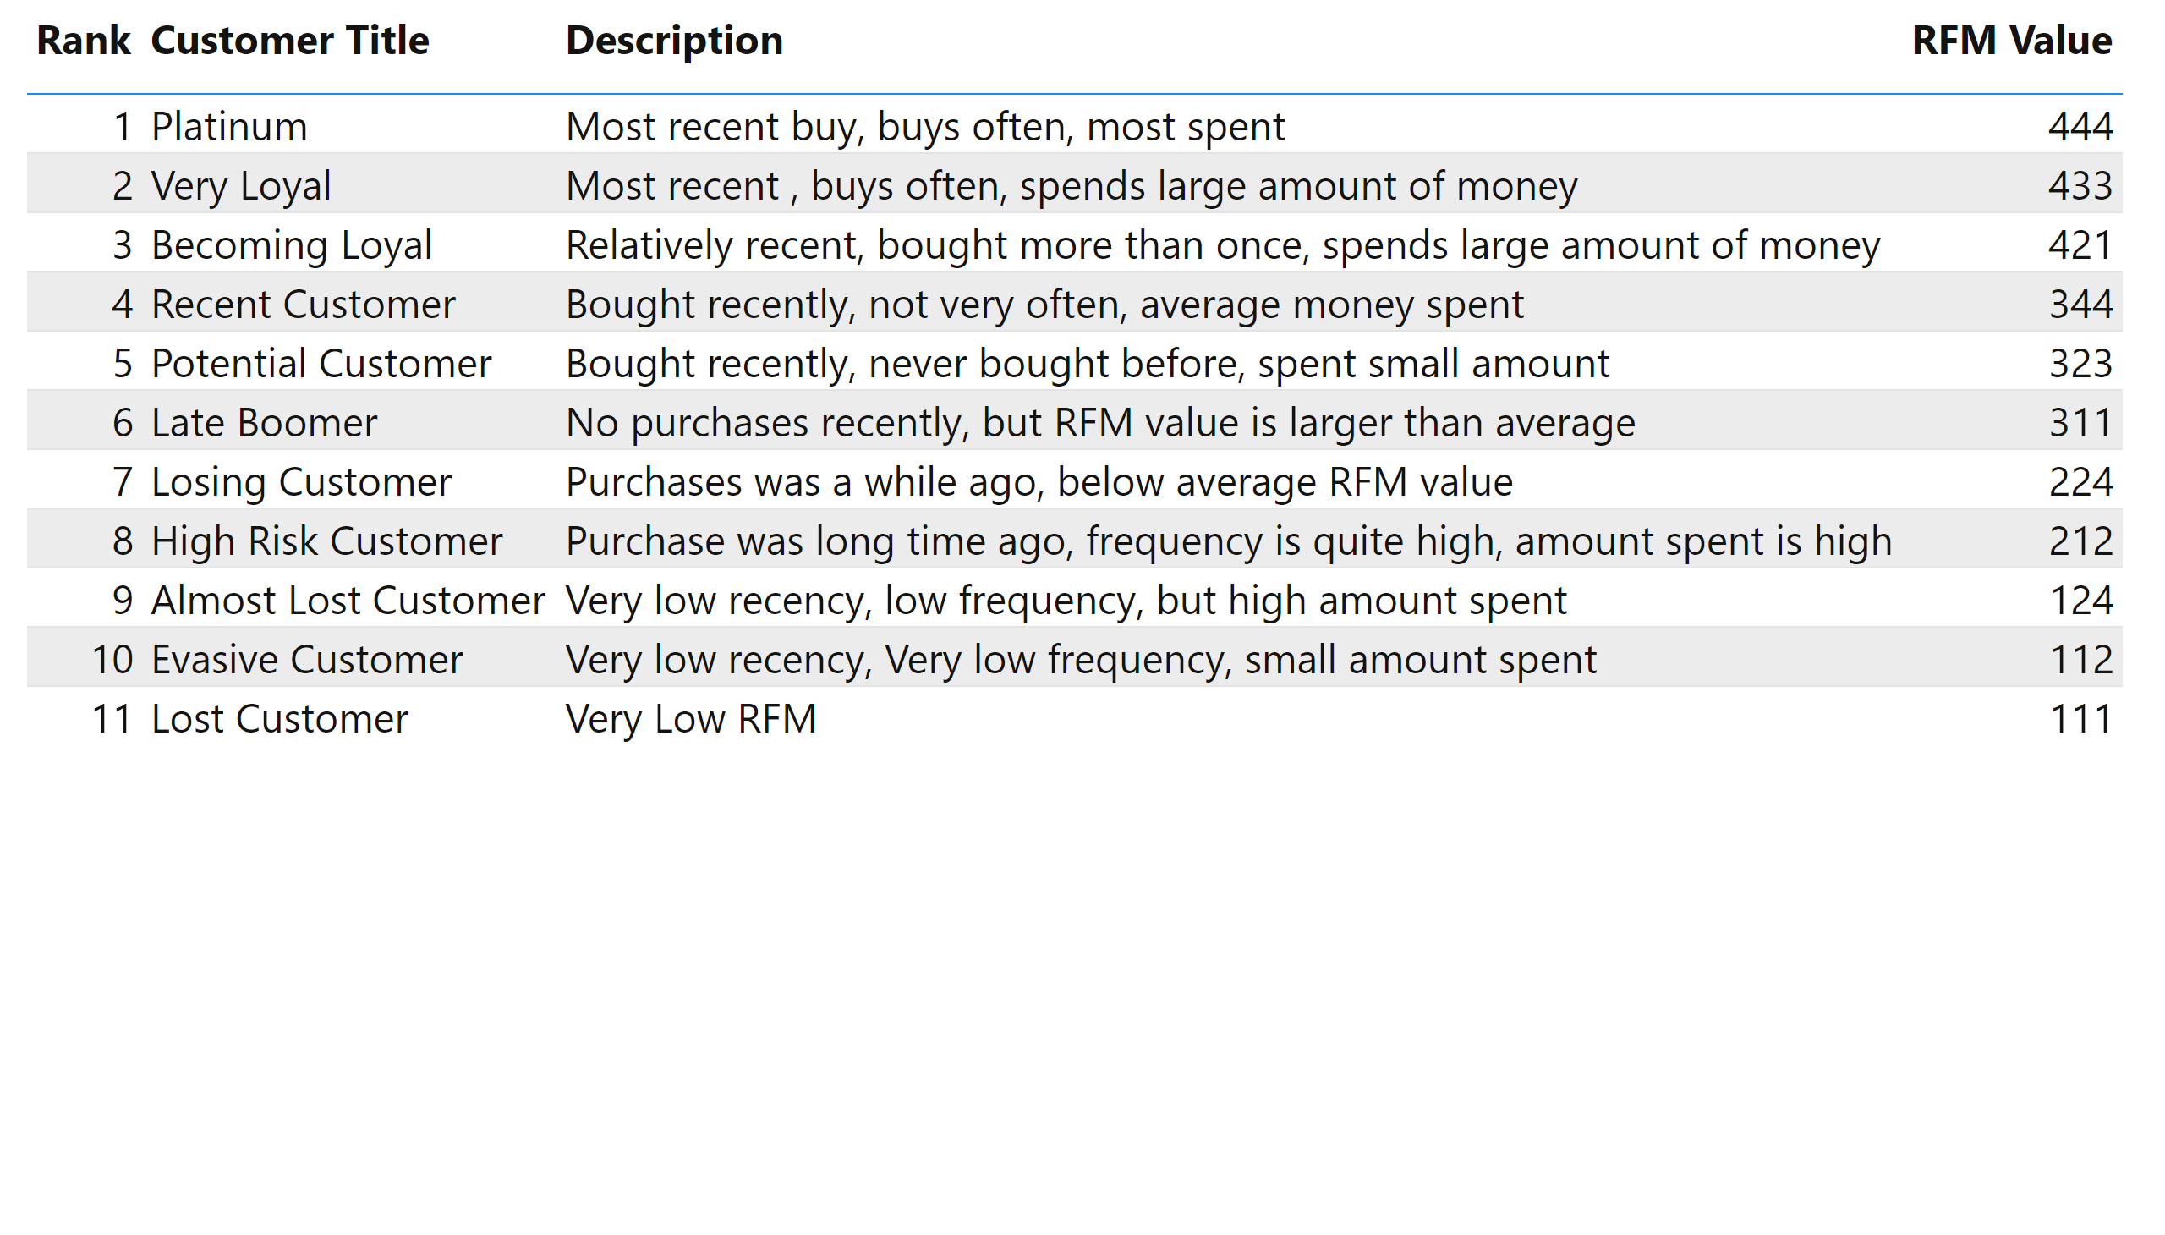
Note: The data and information in this document is reflective of a hypothetical situation and client. This document is to be used for KPMG Virtual Internship purposes only.
Model Development
Customer Title Definition List With RFM Values Assigned

Slide 14
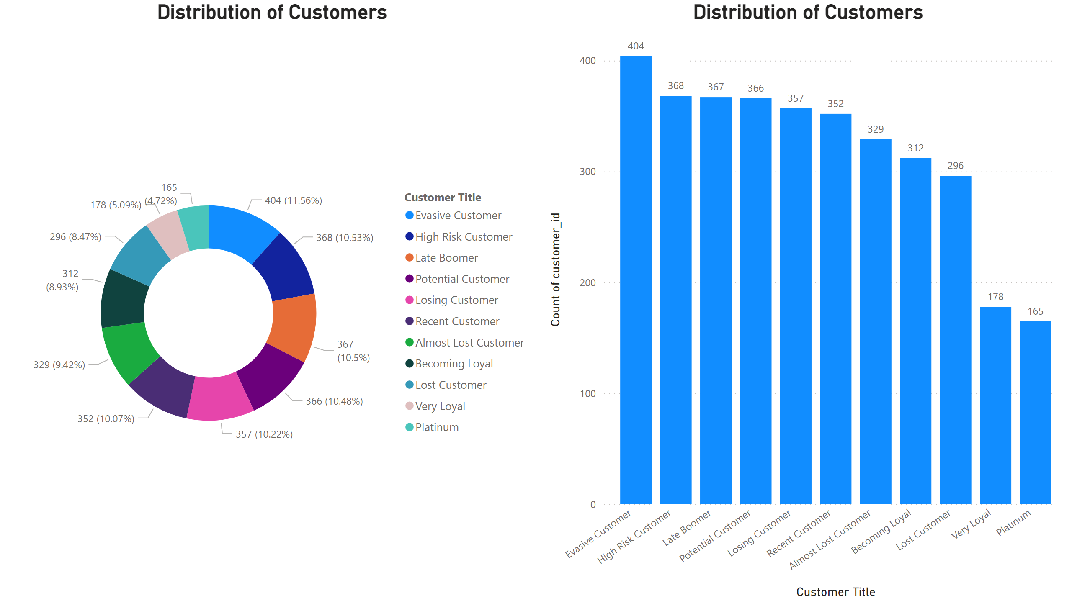
Note: The data and information in this document is reflective of a hypothetical situation and client. This document is to be used for KPMG Virtual Internship purposes only.
Model Development
Customer Title Distributions In Dataset

Slide 15
Note: The data and information in this document is reflective of a hypothetical situation and client. This document is to be used for KPMG Virtual Internship purposes only.
Model Development
Customer Classification – Targeting High Value Customers in the New Customer Data set
These are the high value customers that should be targeted from the new customers list.
Most of the high value customers to be targeted should be females
Working in the Financial Services, Health and Manufacturing industries sectors
Age distribution of 40 – 50 years
Currently living in NSW and VIC

Slide 16
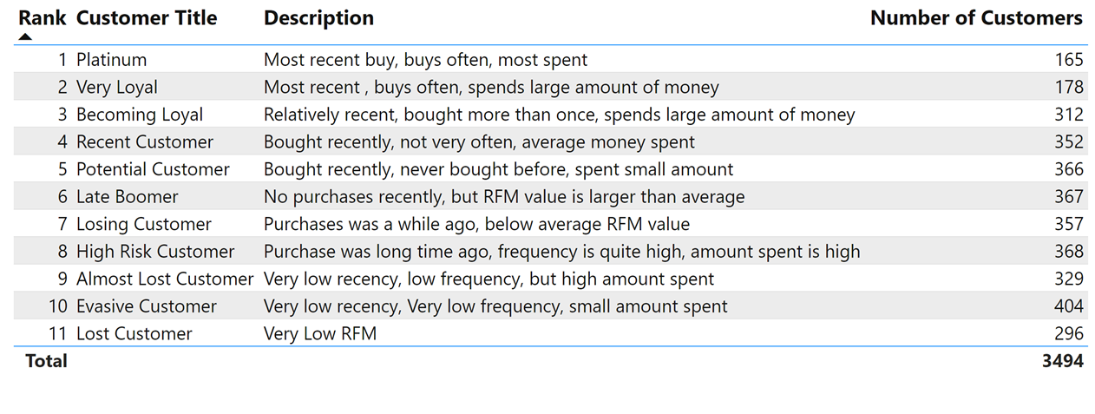
Note: The data and information in this document is reflective of a hypothetical situation and client. This document is to be used for KPMG Virtual Internship purposes only.
Interpretation
Summary Table of the Top 1000 High Value Customers to target from the Existing Customers list
The top 1000 customers can be selected from the table below
The top 1000 customers are the customers who have bought recently, bought frequently and tends to spend more than other customers

Slide 17
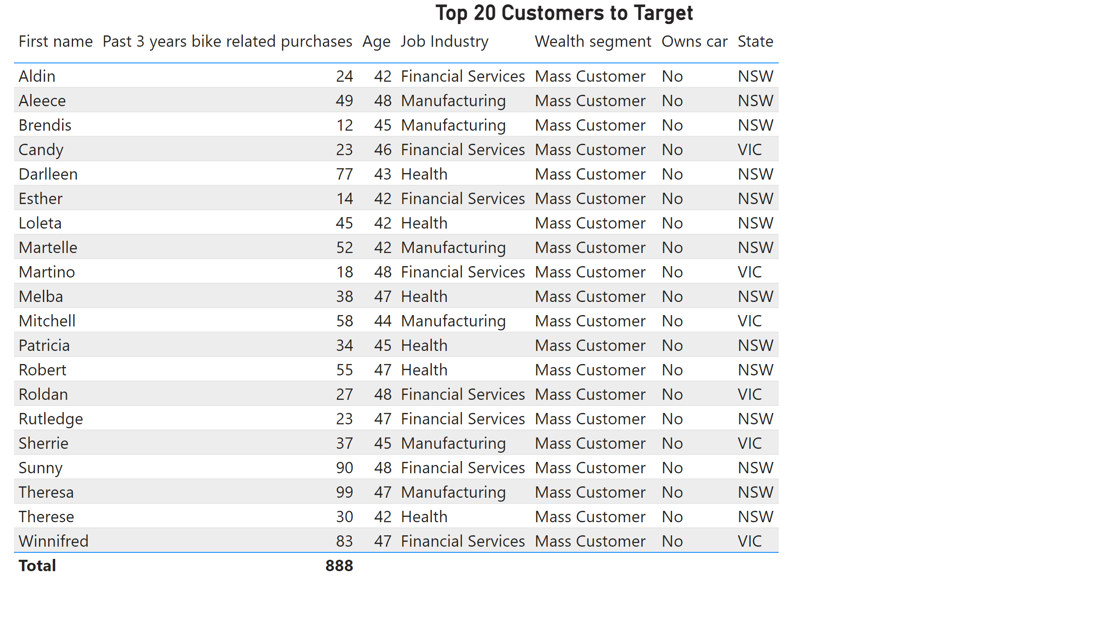
Note: The data and information in this document is reflective of a hypothetical situation and client. This document is to be used for KPMG Virtual Internship purposes only.
Interpretation
Summary table for the high value customers to target from the New Customers Dataset
Below is a snapshot of the top 20 customers to target

Slide 18
Note: The data and information in this document is reflective of a hypothetical situation and client. This document is to be used for KPMG Virtual Internship purposes only.
THANK YOU!

